Slide 1

Notes:
Last month individual stories
This month focused on our collective story
Lawrence, our purpose (John 17)
Harry, the power of our unity
Lauren, the power of mercy, grace, and forgiveness
This morning to wrap it up, I’m gonna zoom out to 30,000 feet and the significance of our work and fruit of long obedience in the same direction

Slide 2
Why Are We Even Here?
Today, we could otherwise:
Listen to world-class preaching anytime, anywhere via the internet.
Worship Jesus and study the Bible on our own using online tools.
Serve people in need or give to worthy causes without belonging to a church.

Slide 3
If You're Like Me…
You're here in part because you want for yourself and for your family to:
Experience Jesus more fully with and through the insights of diverse others.
Become who you might not otherwise become in Christ apart from walking, working, and worshipping together as one with others of varying lived experience.
Help build something together that is biblically informed, deeply compelling, and spiritually significant… something that God uses to bring meaningful hope to our community, influence the global Church, and glorify Him.
Notes:
In 2001, God called us into being.
Some twenty-five years later, He continues to form us according to His purposes.
Together with us, He continues to write our story for His glory.
It's a story worth celebrating, one we should be eager to tell and invite others into.

Slide 4
Part of HIStory
There is nothing inherently wrong about recognizing what God has done or is still doing through a particular church, telling that story for the benefit of others,
and amplifying its witness for the glory of God.
In fact, we are expected to do so.

Slide 5
The Biblical Expectation and Power of Collective Witness
1. The church in Jerusalem
"Day by day continuing with one mind in the temple… they were taking their meals together with gladness and sincerity of heart, praising God and having favor with all the people." (Acts 2:46-47)
2. The church in Antioch
"...when Barnabas came and saw the grace of God, he was glad... And the disciples were first called Christians in Antioch." (Acts 11:23, 26)
3. The church in Rome
"...your faith is proclaimed in all the world… your obedience is known to all." (Rom. 1:8; 16:19)
4. The church in Thessalonica
"...you became an example to all the believers in Macedonia and in Achaia... your faith in God has gone forth everywhere." (I Thes. 1:7-8)
5. The church in Corinth
"You yourselves are our letter... known and read by all… a letter from Christ…" (II Cor. 3:2-3)

Slide 6
The Biblical Expectation and Power of Collective Witness
6. The church in Ephesus
"His intent was that now, through the church, the manifold (Gr., multicolored) wisdom of God should be made known to the rulers and authorities in heavenly places, in accordance with His eternal purpose that He accomplished in Christ Jesus our Lord."
"For He Himself is our peace, who made both groups into one and broke down the barrier of the dividing wall, by abolishing in His flesh the hostility (historic animosities)… so that in Himself He might make the two one new person, in this way establishing peace; and that He might reconcile them both (Jews and Gentiles) in one body to God through the cross, by it having put to death the hostility." (Eph. 2:14-16)
"And they sang a new song, saying, 'Worthy are You to take the scroll and to break its seals; for You were slaughtered, and You purchased people for God with Your blood from every tribe, language, people, and nation.'" (Rev. 5:9)

Slide 7
The Fulfilment of His Eternal Purpose
7. The Church in Heaven
"His intent was that now, through the church, the manifold (Gr., multicolored) wisdom of God should be made known according to His eternal purpose that He accomplished in Christ Jesus our Lord."
After these things I looked, and behold, a great multitude which no one could count, from every nation and all the tribes, peoples, and languages, standing before the throne and before the Lamb, clothed in white robes, and palm branches were in their hands; and they cried out with a loud voice, saying, “Salvation belongs to our God who sits on the throne, and to the Lamb.” (Rev. 7:9)

Slide 8
The question isn't whether a church should recognize and tell its collective story.
The question is for what purpose, for whose benefit, and for whose glory?

Slide 9
1. For What Purpose?
A. To know God and to make Him known through the pursuit of unity in accordance with the prayer of Christ in John 17 and patterned after the New Testament church in Antioch.
B. To advance a credible and compelling witness of the Gospel.
C. To challenge twentieth-century understanding and application of the Homogeneous Unit Principle.

Slide 10
The Homogeneous Unit Principle
People come to Christ fastest when they don't have to jump through linguistic, class, and cultural barriers. (Donald McGavran)
Churches grow fastest when they are homogeneous (Peter Wagner)
This pragmatic observation was widely adopted and eventually treated as though it were biblically normative.

Slide 11
The Homogeneous Unit Principle
By 2000, sociologists Michael Emerson and Christian Smith were documenting how evangelical structures could perpetuate racial division. - Divided By Faith
In 2001, Mosaic was planted to demonstrate that what Christ envisioned (John 17), Luke described (Acts 11), and Paul prescribed throughout his life and writings is not just nice but necessary, not optional but biblical.
In 2004, together with Dr. George Yancey (Baylor University) we launched the Mosaix Global Network believing that multiethnic churches are essential in the 21st century to advancing a credible gospel witness and demonstrating God’s love for all people in an increasingly diverse, painfully polarized, and cynical society.
Notes:
We weren’t the first church to be multi, but we were very early in and became perhaps the most vocal and proliferate in terms of writing challenging the American church relentlessly and word indeed. One of the consistent comments we get from people who visit is what you say in your books is what we experience here and that’s unusual and refreshing. Even this week leaders from the largest church planning movement will be with us on Friday.

Slide 12
2. For Whose Benefit?
A. The multiracial church movement has witnessed demographic success.
  In 1998, only about 7.5% of all American religious congregations of any faith were multi-racial.
  By 2019, that figure had increased to about 18%, a growth of 240%.
B. In 1998, less than 5% of conservative Protestant congregations were multiracial, but by 2019, more than 20% were racially diverse, an increase of more than 400%.
C. By 2024…
  Catholic: from 17% (1998) to 22% (2024)
  Mainline: from 5% (1998) to 17% (2024)
  Evangelical: from 7% (1998) to 24% (2024)
Notes:
Such congregations remain the clear minority, but this is a substantial change over a 20-year period.
Among evangelicals, that change has been even more dramatic.

Slide 13
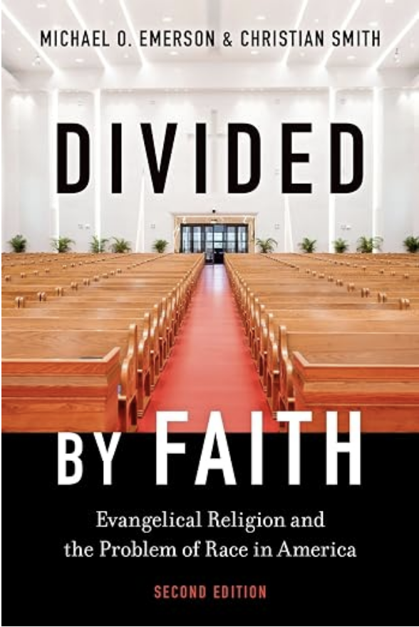
Michael Emerson • Divided By Faith (second edition, 2025)
"These changes did not happen by chance. Two factors were key. First, growing racial and ethnic diversity in the United States… Second, various parachurch organizations and denominations explicitly embraced increasing the number of diverse congregations as a concrete goal. Mosaix, for instance, is an organization that aims to increase the number of multiethnic churches by supporting their growth and healthy functioning. …By the 2020s, the organization had created a national network of church planters and pastors of multiracial congregations and hosted conferences attended by thousands, in addition to supplying an abundance of materials and local networks in support of diverse, socially just congregations."
Notes:
In 2006… Mosaix goal: by 2020 20% of churches would be multiethnic

Slide 14
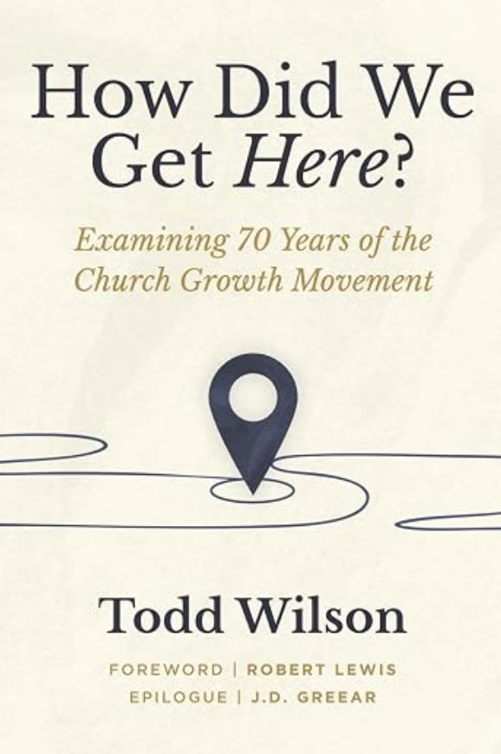
Todd Wilson • How Did We Get Here? (2026)
"The multiethnic movement was unique in one important respect: it was the only innovation that some leaders perceived as directly challenging any of McGavran's foundational principles. …The multiethnic movement said that the homogeneous unit principle, whatever its merits in cross-cultural evangelism, discipleship, and missionary context, had produced something in American evangelicalism that contradicted the gospel's reconciling vision. Sunday morning shouldn't be the most segregated hour. The church should look like the kingdom it proclaimed." (p. 332)
Notes:
See Chapter 25 - Mosaic discussed on p. 325

Slide 15
"You won the argument."
Dr. Michael Emerson and Dr. Ed Stetzer
Mosaix Conference, Dallas, TX • November 2025
Notes:
Of course, there's more work to be done.
By 2050 11 AM on Sundfay morning will be kjnown as the most integrated hour of the week

Slide 16
Global Expansion (2026-2050)
For more than fifty years, Disciple-Making Movements (DMMs) and Church Planting Movements (CPMs) have represented one of the great missiological recoveries of the modern missionary era. They have helped restore biblical convictions that every believer can make disciples, multiplication is God's pattern for advancing His Kingdom, and indigenous leaders should lead indigenous movements. Millions have come to Christ and hundreds of thousands of churches have been planted around the world.
The question is not whether DMMs and CPMs remain effective. The question is:
What kind of churches are we multiplying?

Slide 17
Global Expansion (2026-2050)
The twentieth century witnessed a remarkable recovery of intentional disciple-making and church multiplication.
The twenty-first century must build upon that recovery by giving equal intentionality to reconciliation.
Indeed, the next great advance of global missions may result from planting and multiplying churches that increasingly become living demonstrations of Christ's prayer in John 17: “that they may all be truly one... so that the world may believe.”

Slide 18
When a world at war sees a people at peace, it will run to the local church, not from it.

Slide 19
For Whose Glory?
For we are His workmanship, created in Christ Jesus for good works, which God prepared beforehand so that we would walk in them. (Ephesians 2:10)
Your light must shine before people in such a way that they may see your good works, and glorify your Father who is in heaven. (Matthew 5:16)

